Slide 1
DevOps Zero to DevOps Hero with Visual Studio Team Services (VSTS)
Any Language, Any Platform

Slide 2
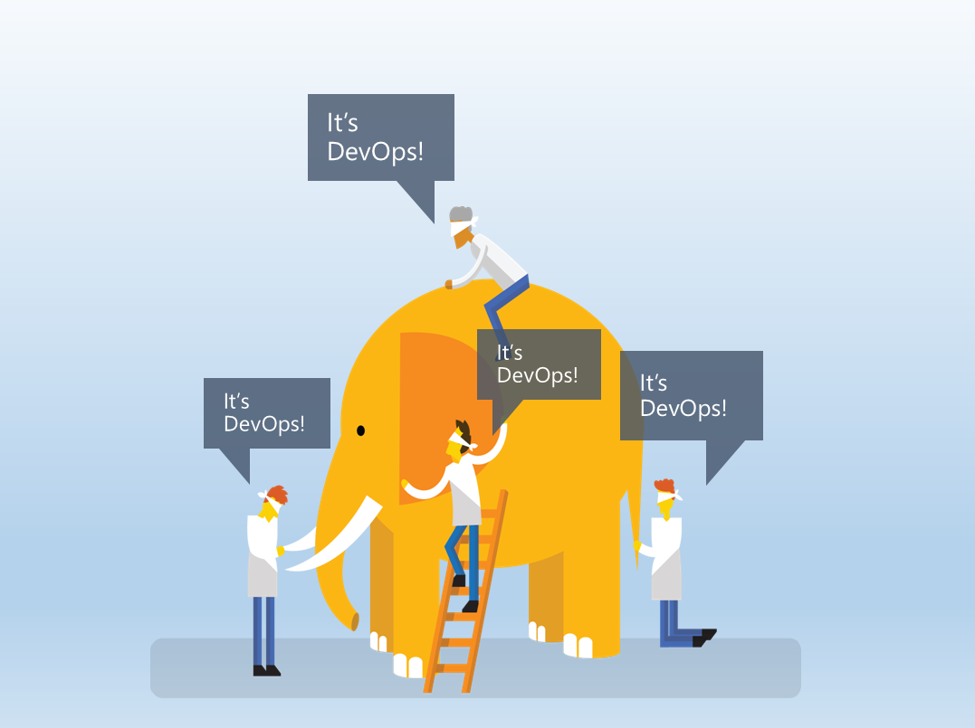
Notes:
DevOps - one of the many buzz words that you hear in the industry today (just up there with 'cloud computing', 'artificial intelligence' and so on) but what is it really?
ask people what they think about when they hear 'devops‘
would anybody want to define it?

Slide 3
“DevOps is the union of people, process, and products to enable continuous delivery of value to our end users.”
Donovan Brown
http://www.donovanbrown.com/post/what-is-devops
Notes:
Using ‘value’ instead of ‘software’ or ‘features’ - ecommerce with cyber monday coming –
value means stable infrastructure with ability to sustain increased load ... not necessarily new exotic features
hardest part in the union - the people ... not everybody will be on board or want to be on board
DevOps is not just automating a pipeline so we can quickly deliver software. Our goal is to deliver value.
If the value only reaches the Dev and QA environments but is held up before reaching production we're still failing
DevOps is not a product. You cannot buy DevOps and install it. DevOps is not just automation or infrastructure as code.
DevOps is people following a process enabled by products to deliver value to our end users.

Slide 4
Why is DevOps important
Every company is a software company
Your competition is already doing this
Increase velocity
Reduce downtime
Reduce human error
Notes:
competition - mobile apps - fiercely competitive market ... for every app you have on the phone there are probably at least another dozen trying to do the same exact thing
if you don't add value fast enough your customers will become their customers ... you either implement devops to add value quickly or you lose
we want to increase velocity, move faster but historically when we move faster we incur more risk - especially when manual steps are involved
quote - friends don't let friends right-click on projects to 'publish' them from Visual Studio
quote - never ever ever send a human to do a machine's job ... mistakes will happen
a user should at most have to click to select which release should be deployed - all else should be automated

Slide 5
DevOps Practices
Infrastructure as Code (IaC)
Continuous Integration
Automated Testing
Continuous Deployment
Release Management
App Performance Monitoring
Load Testing & Auto-Scale
http://www.itproguy.com/devops-practices/
Notes:
Continuous Integration (CI)
the process that ensures the stability of all the available developer source code
automated builds of each code submitted and the execution of the unit tests
Continuous Delivery (CD)
ensures every change can be deployed to production while having the option to hold the production deployment until a manual approval is given
Continuous Deployment
lets every change to be automatically deployed to production
created by automating the approval steps of continuous delivery

Slide 6
DevOps Practices
Availability Monitoring
Capacity Management
Change/Configuration Management
Feature Flags
Automated Environment De-Provisioning
Self Service Environments
Automated Recovery (Rollback & Roll-Forward)
http://www.itproguy.com/devops-practices/
Notes:
Feature flags - technique to turn on/off functionality of your application, via configuration, without deploying new code
they're important to allow work to reside in the main branch even if should not be visible to the end users
key part in CI scheme where features are constantly being deployed but not necessarily "released" into production
some say it's ok to even add code protected by a feature flag even if the feature is not fully finished (as long as the code compiles and nothing else is affected)

Slide 7
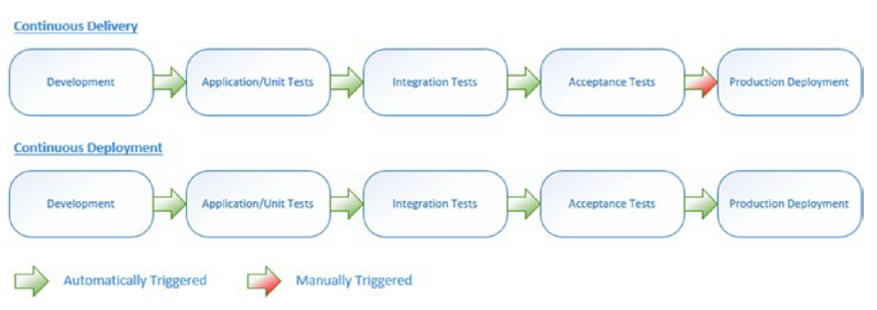
Continuous delivery vs. continuous deployment

Slide 8
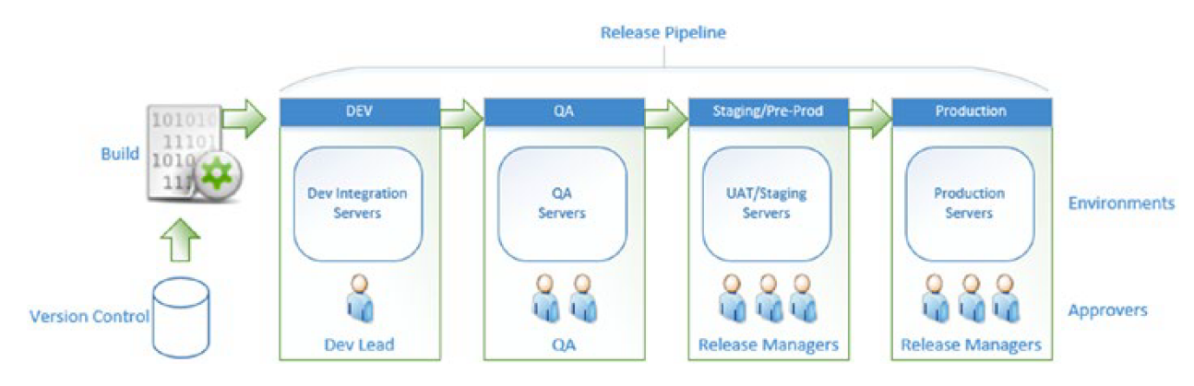
Release pipeline
Notes:
the goal is to deploy the same binaries/packages (built only once) across the entire pipeline
each deployment stage definition in the release flow should contain the configuration values specific to that stage

Slide 9
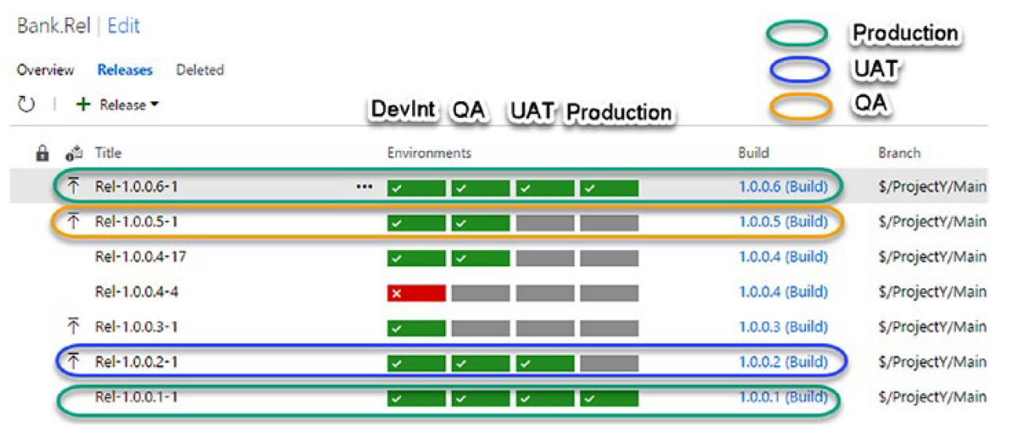
Releases & environments
Notes:
what is one major risk with the approach we often take here with one code branch per environment?
merging code into other branches is painful and can be dangerous
it's possible that code that was tested in QA for a given branch might not end up exactly the same in the prod branch for deployment (if the dev doing the merge is not careful)
best practice - one main branch, protected (code is only added via pull requests that are reviewed) with short-lived feature branches (usually only around for a few days)
discussion on Twitter with devops advocates from Microsoft's VSTS team
http://stevenmurawski.com/powershell/2017/06/pruning-the-source-tree/
https://damianbrady.com.au/2017/07/12/continuous-integration-not-continuous-isolation/
https://trunkbaseddevelopment.com/
https://www.continuousdelivery.com/foundations/continuous-integration/

Slide 10
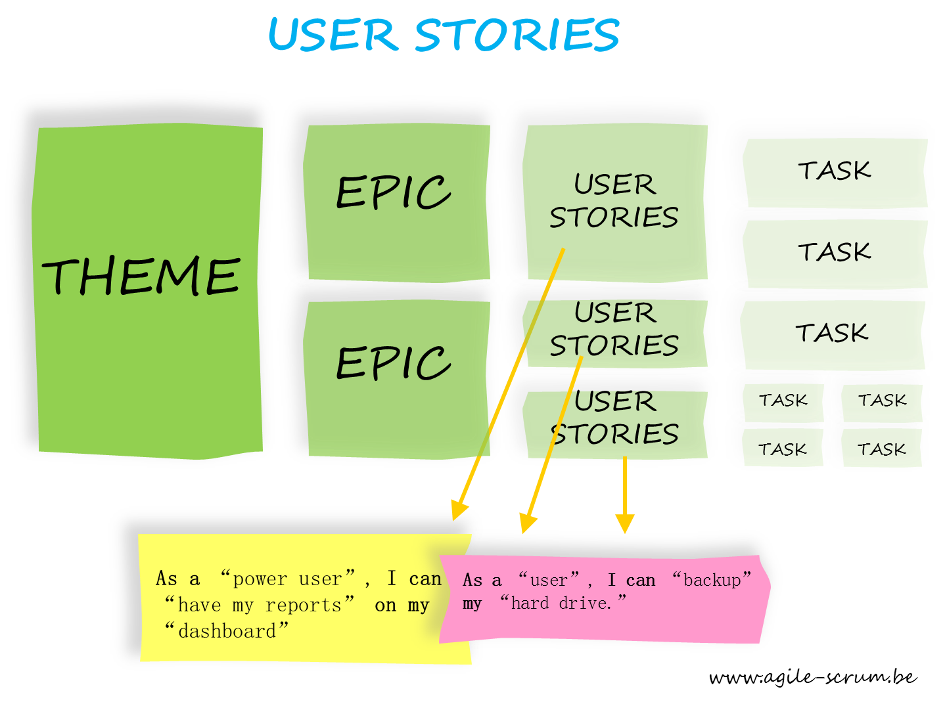
Notes:
Let’s look now for a little at agile methodologies and agile components
User stories - short, simple descriptions of a feature told from the perspective of the person who desires the new capability, usually a user or customer of the system
User stories are written throughout the agile project
Some of these agile user stories will undoubtedly be epics. Epics will later be decomposed into smaller stories that fit more readily into a single iteration.

Slide 11
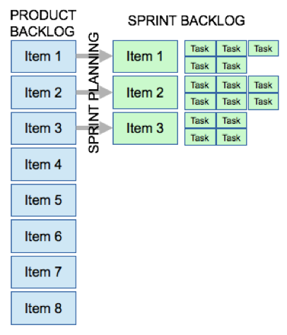
Product backlog
Notes:
a prioritized list of the functionality to be developed in a product or service
the development team pulls work from the product backlog as there is capacity for it, either continually (kanban) or by iteration (scrum)
Keep everything in one issue tracker–don’t use multiple systems to track bugs, requirements, and engineering work items. If it's work for the development team, keep it in a single backlog

Slide 12
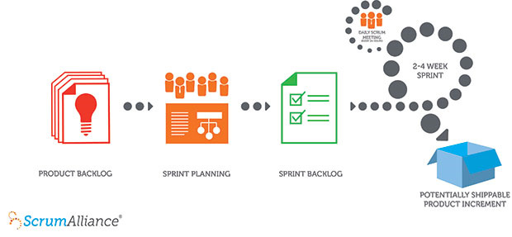
Scrum process
Notes:
one of the most popular frameworks for implementing agile
many people think scrum and agile are the same thing (they're not)
Many frameworks can be used to implement agile, such as kanban for example, but scrum has a unique flavor because of the commitment to short iterations of work
product is built in a series of fixed-length iterations called sprints that give teams a framework for shipping software on a regular cadence

Slide 13
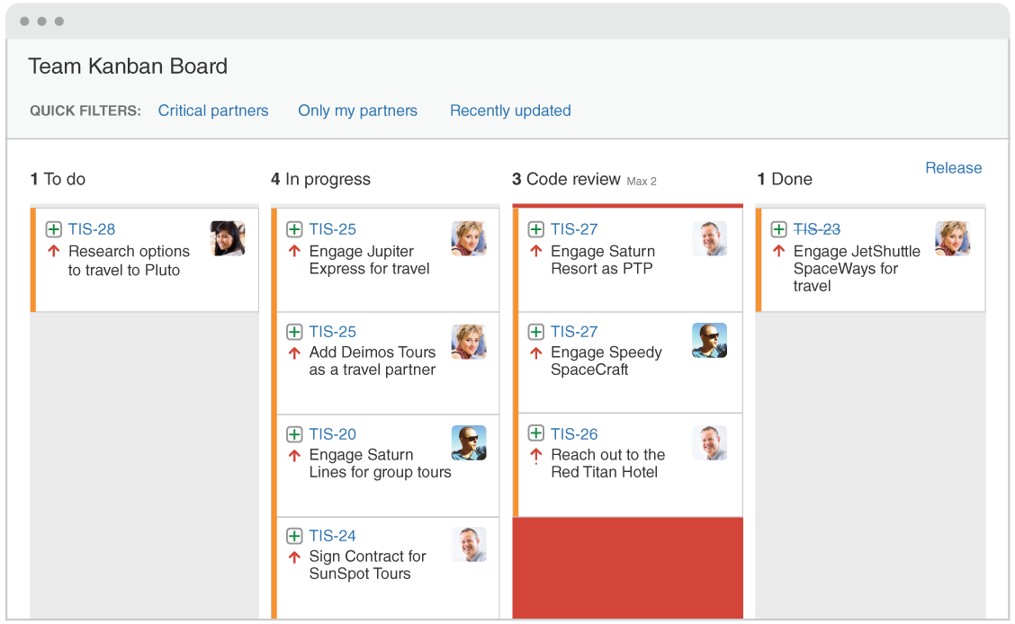
Kanban
Notes:
In Japanese, kanban literally translates to "visual signal"
Work items are represented visually on a kanban board, allowing team members to see the state of every piece of work at any time
Once the team completes a work item, they pluck the next work item off the top of the backlog
As long as the product owner keeps the most important work items on top of the backlog, the development team is assured they are delivering maximum value back to the business

Slide 14
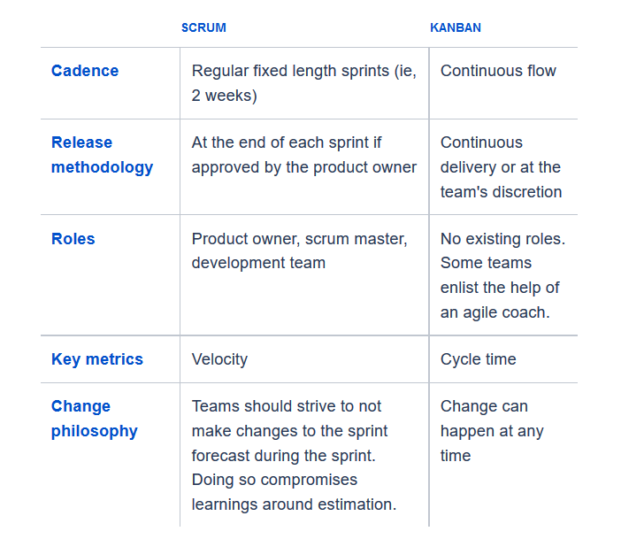
Scrum vs. Kanban

Slide 15
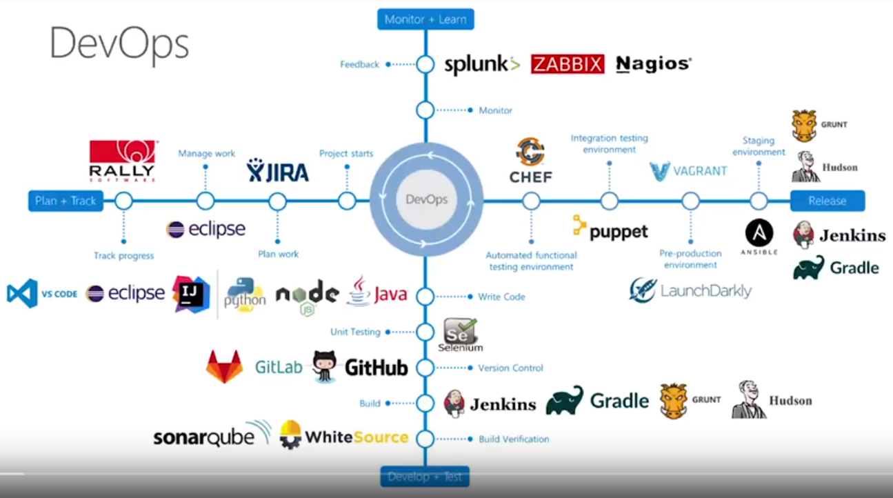
Notes:
DevOps ecosystem
the various third-party options we might typically have to integrate with in order to plan/track, develop/test, release and monitor

Slide 16
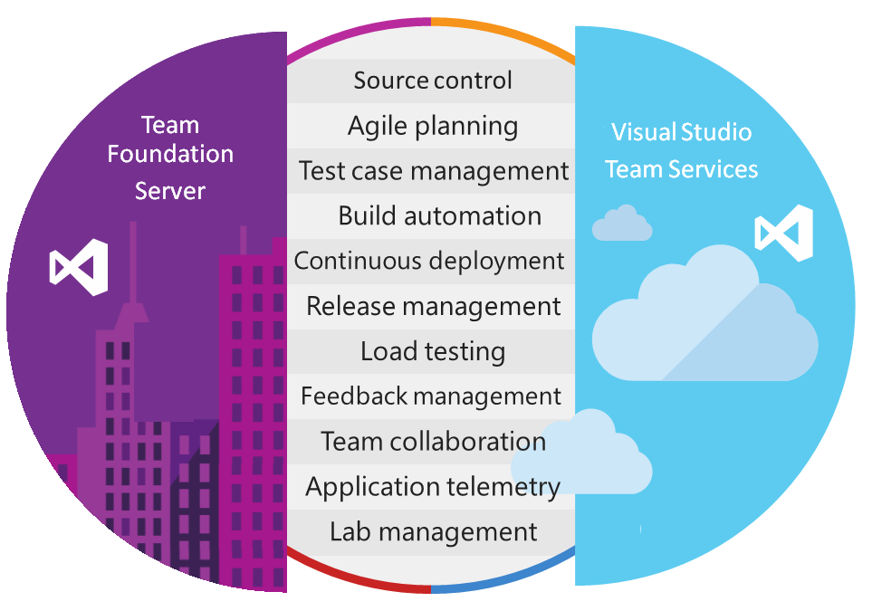
Notes:
TFS is the on-premises product (it's been around since 2005 - it's a few months behind in available features compared to VSTS)
sign-up for VSTS at https://www.visualstudio.com/
VSTS - managed ... never have to upgrade it, back it up, secure it, infinite scale
VSTS offers all the capabilities you need to turn an idea into a piece of working software ... but you don't have to use all of it
no other vendor offers all these capabilities into a single product - if you follow these steps with outside vendors then you will pay an integration tax
the Microsoft VSTS devops team is very serious about trying to offer the best of breed features in each of the categories above (if not just tweet @donovanbrown)
with GVFS (git virtual file system) can support extremely large repos (hundreds of gigabytes) - offered by Microsoft as an open-source project to GitHub to extend git for everybody
used by tens of thousands Microsoft engineers working on various Microsoft products including Windows itself (300+ GB repo)
VSTS itself is developed, tracked, deployed using VSTS (one of those moments from the inception movie)
VSTS - free account limits
https://www.visualstudio.com/team-services/compare-features/
https://www.visualstudio.com/team-services/pricing/
teams of 5 users or less are free
hosted pipelines
240 minutes of free total compute time per month from a hosted agent to run a build or a release
each build or release job within this free allocation cannot run for more than 30 minutes

Slide 17
Any Language, Any Platform
Program in any language
.NET
Java
Python
Ruby
Node.js
…
Develop on any OS
Linux
Mac
Windows
Deploy to any Platform
Android
iOS
Windows Phone
Docker
Azure
AWS
Linux
Mac
…
Notes:
Microsoft again is not the best at naming stuff with VSTS ... it's really not related to Visual Studio though it does have a nice integration experience with it
Microsoft's devops team is trying hard to transmit the 'any platform, any language' message
stress that VSTS is a managed service - when used fully there is no need to run & manage Gitorious, Jenkins, Redmine, Trello and so on
it's offered by Microsoft but it can be used for any platform and any language
very extensible - external components can be plugged in at various points in the pipeline
keep source code in GitHub but use VSTS for everything else
do builds in an external Jenkins instance and just pick up the artifacts to use VSTS for deployment
mention that VSTS integration tools exist for many other development environments - Eclipse, IntelliJ, Visual Studio Code and so on
same with ability to use whatever git tools you're already comfortable with

Slide 18
Demo with VSTS

Slide 19
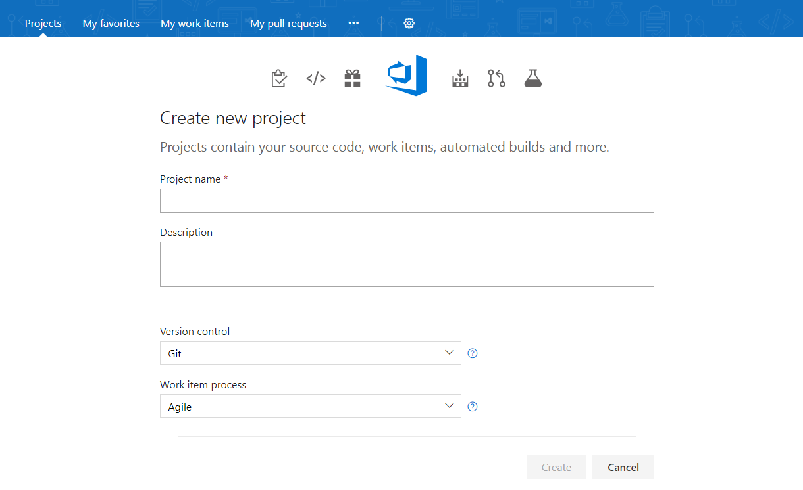
New project options

Slide 20
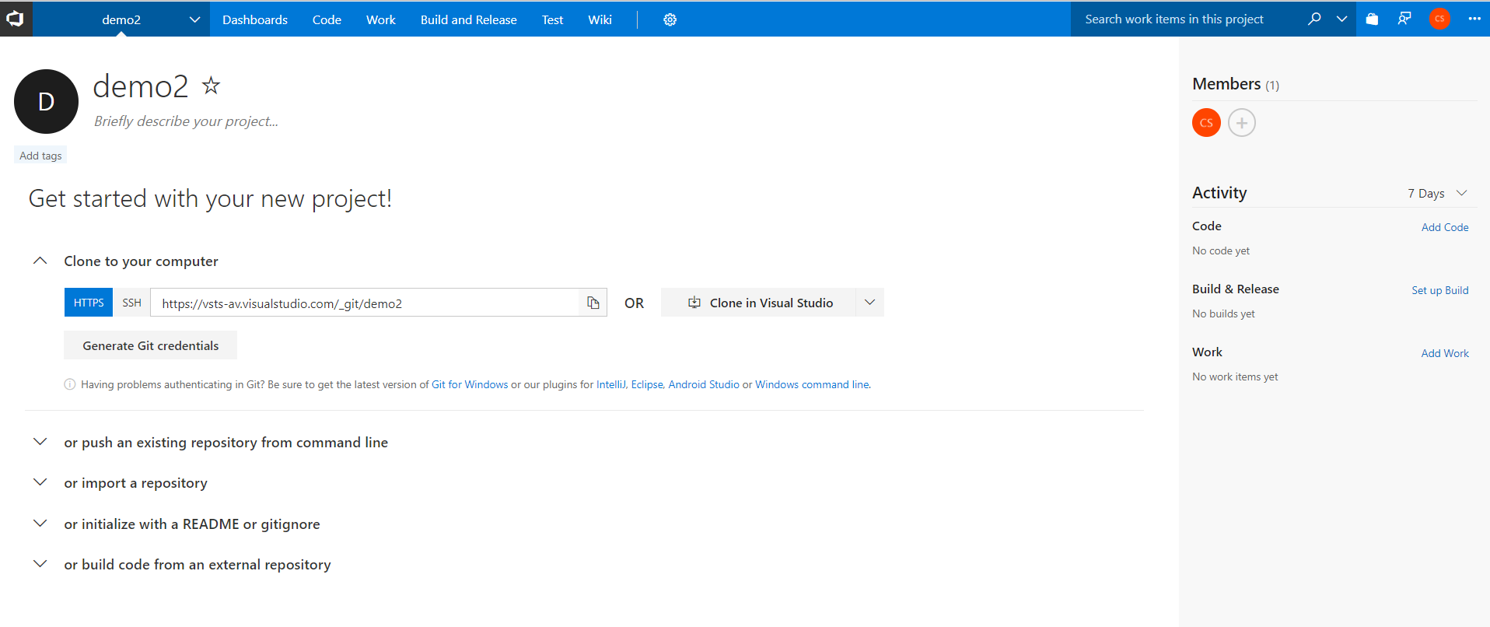
Source control options

Slide 21
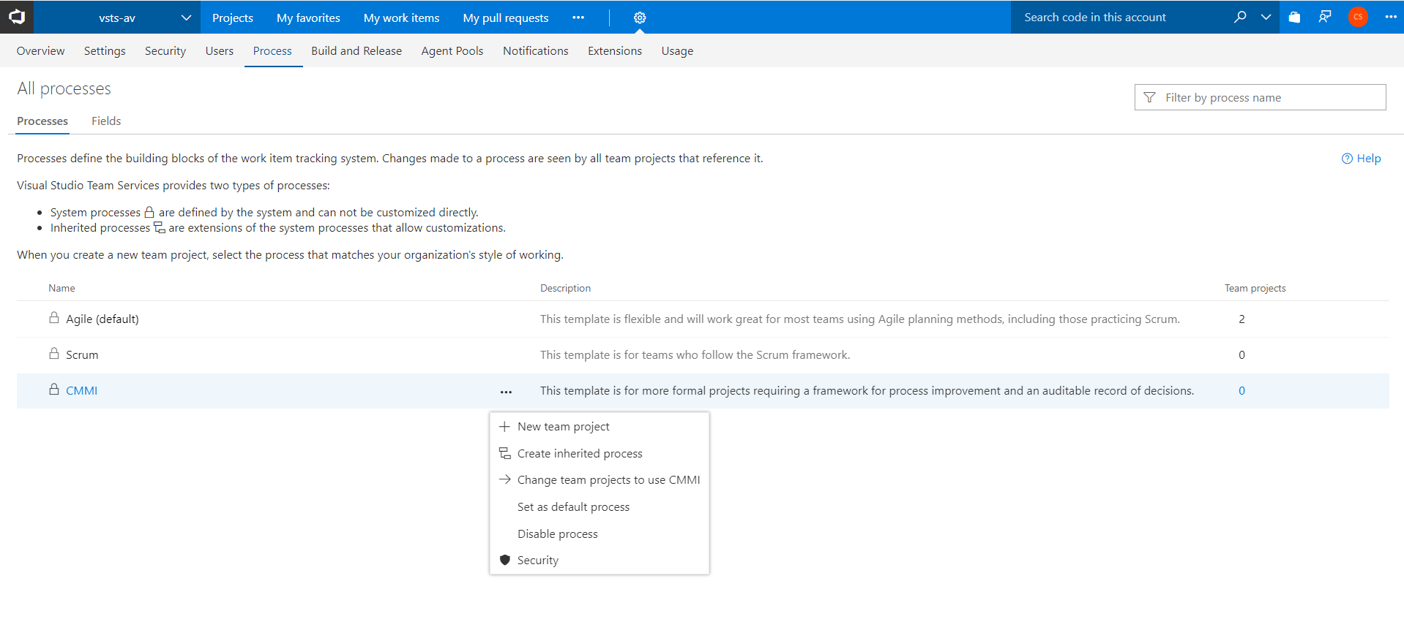
Process customization

Slide 22
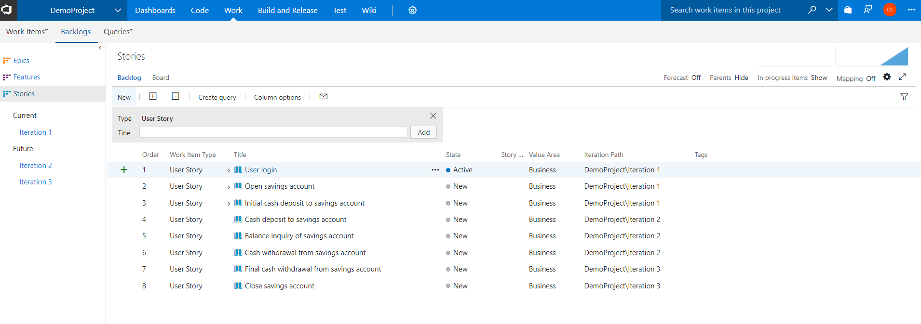
Backlog

Slide 23
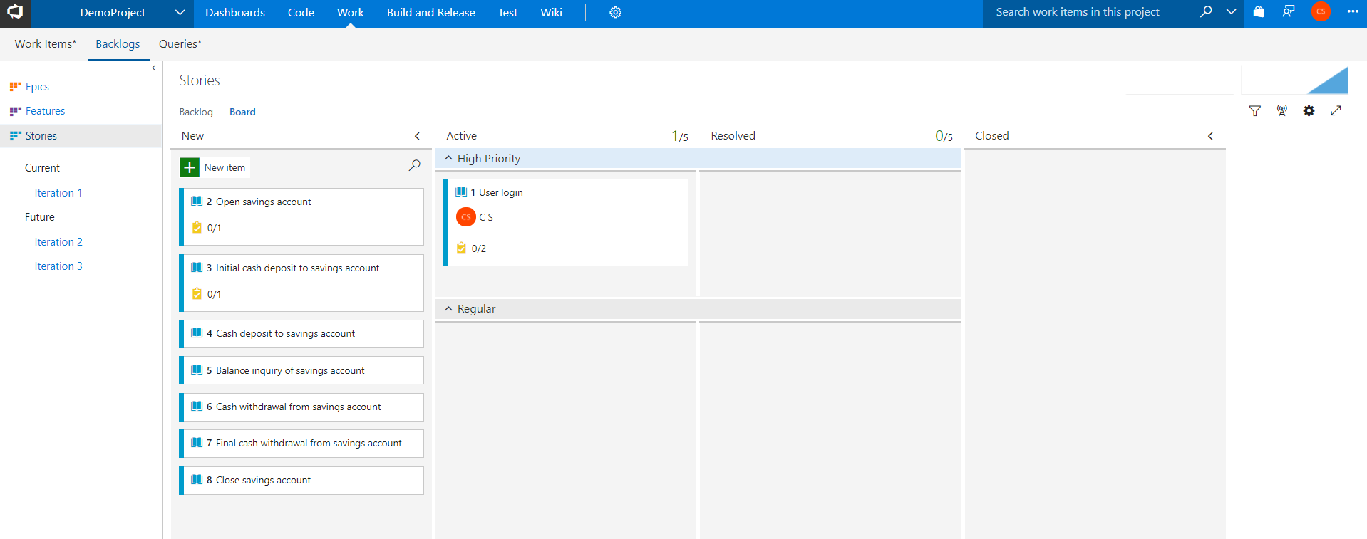
Kanban board

Slide 24
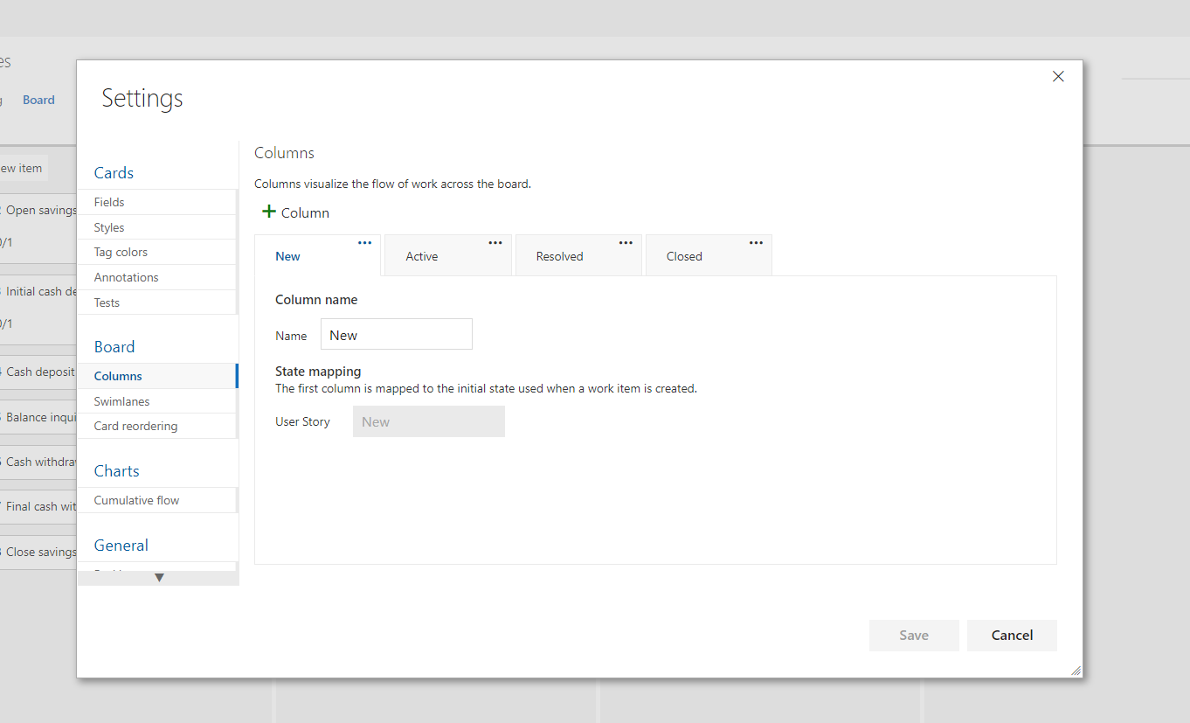
Kanban customization

Slide 25
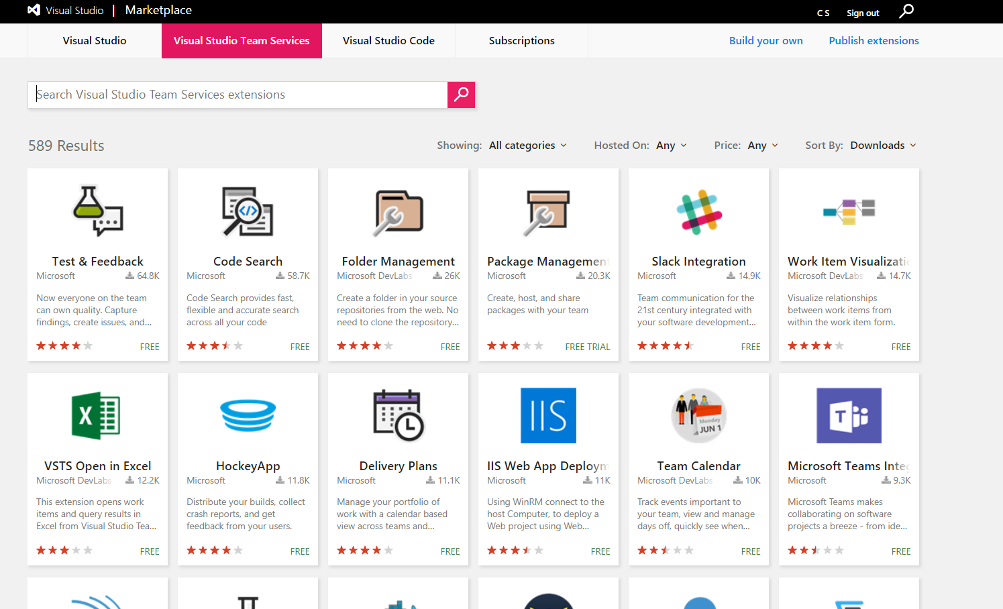
VSTS marketplace

Slide 26
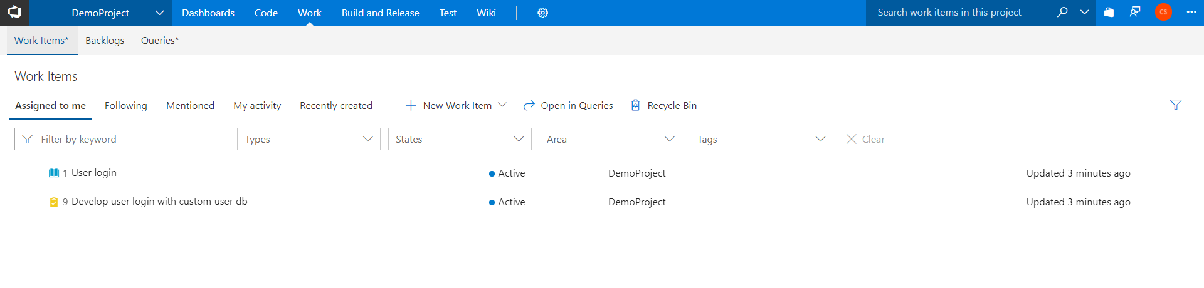
Work items

Slide 27
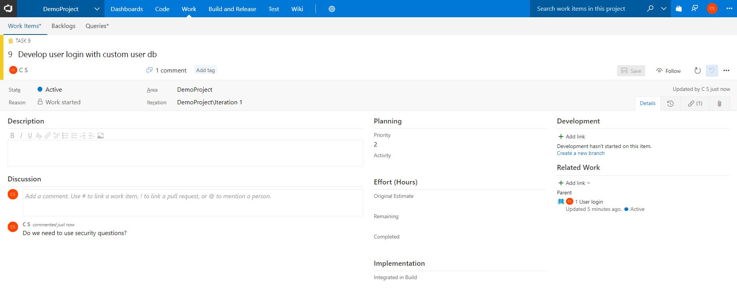
Work item details

Slide 28
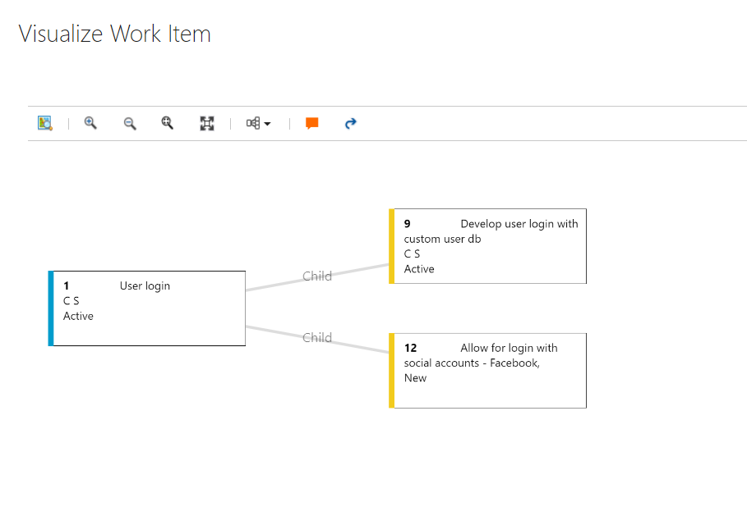
Work item visualization

Slide 29
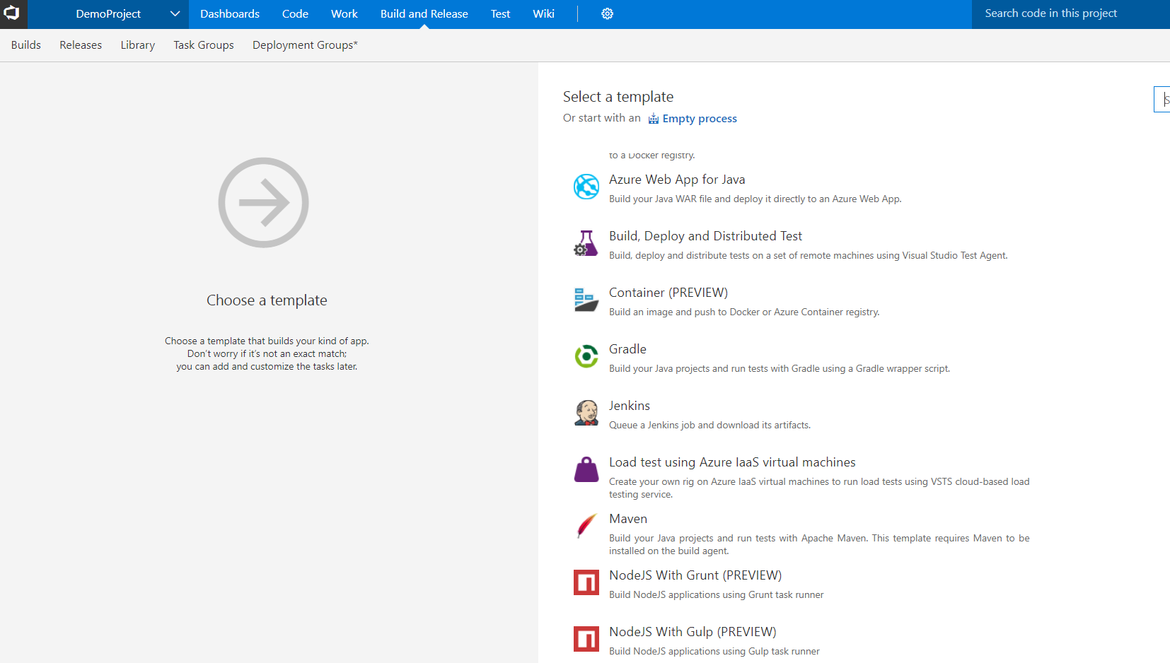
Build templates

Slide 30
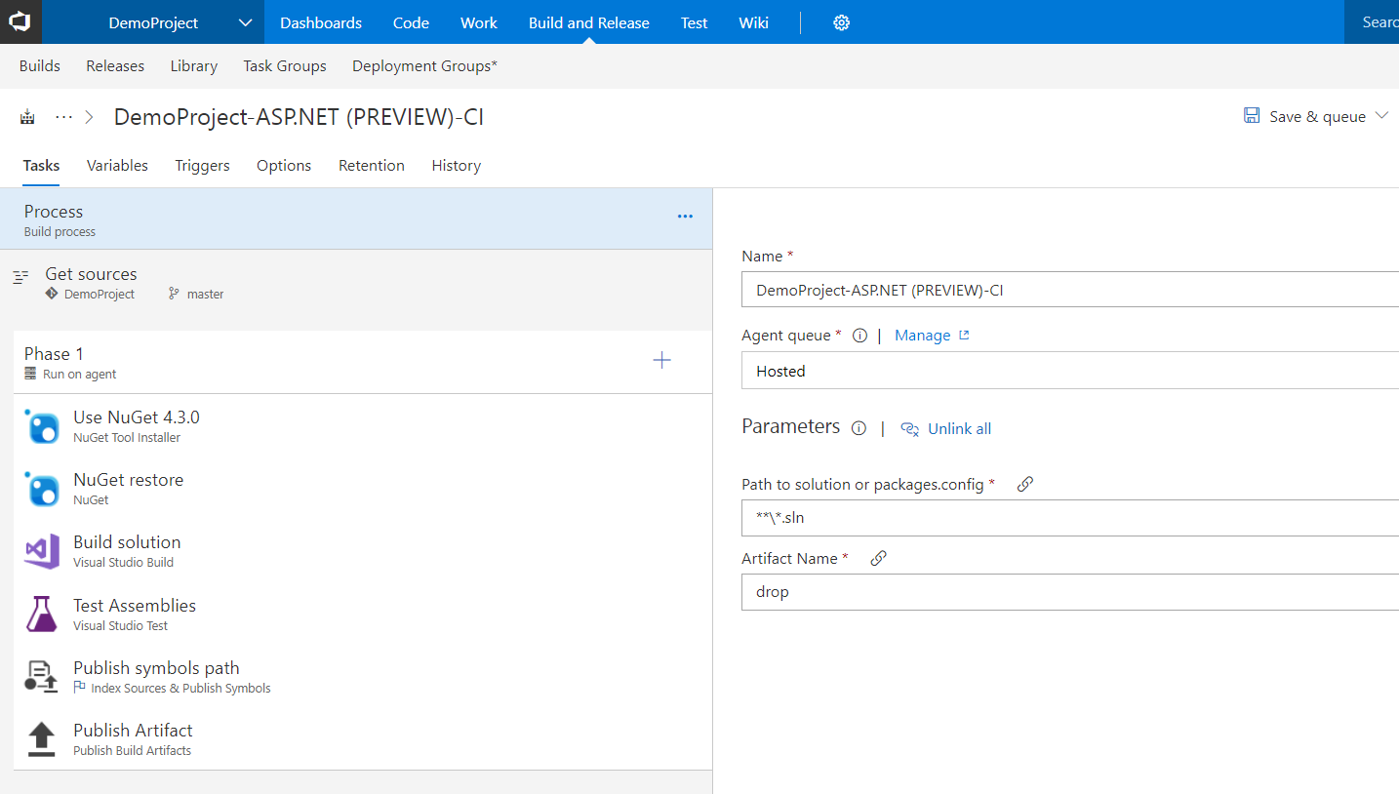
Build template options

Slide 31
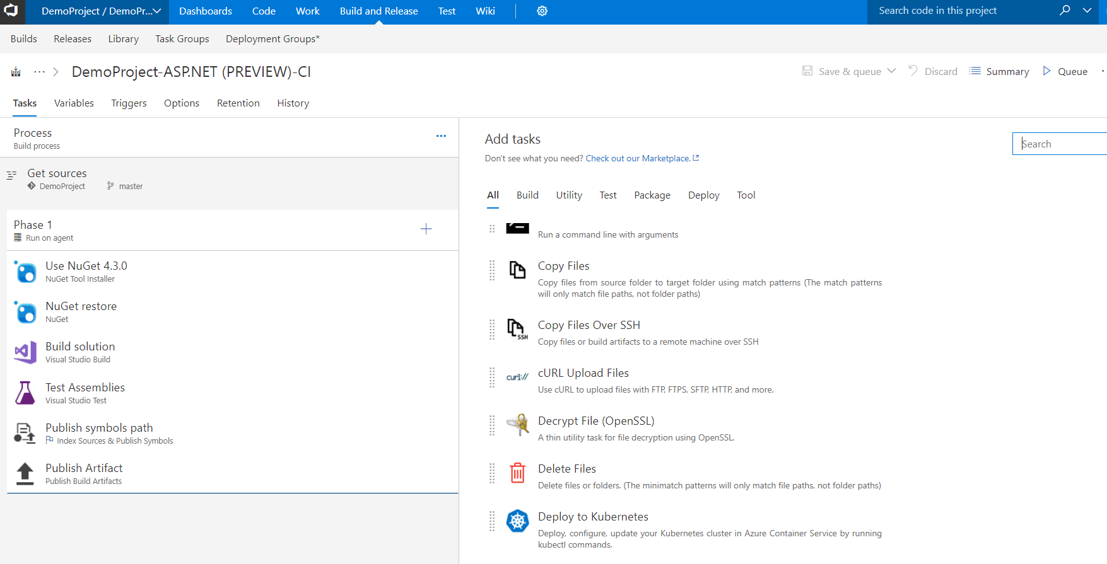
Build add tasks

Slide 32
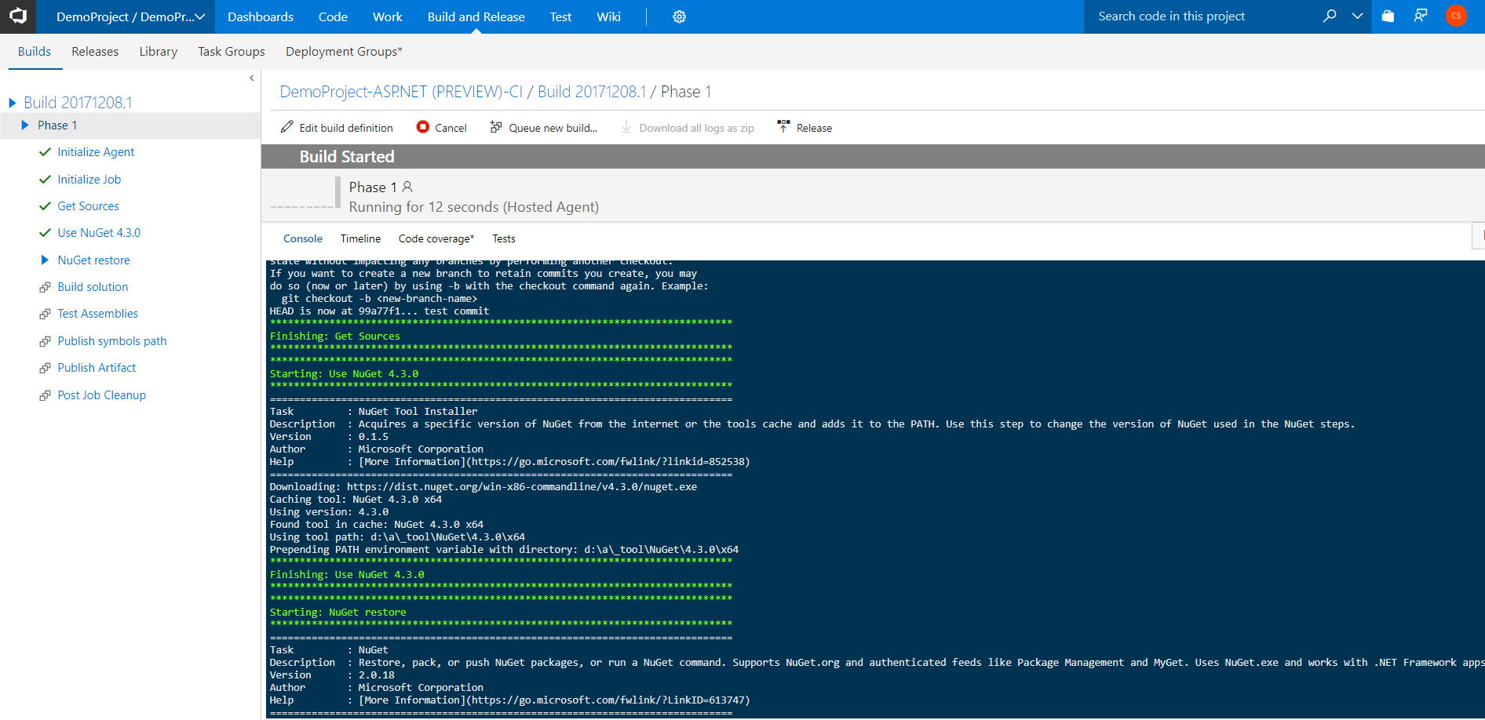
Build live progress

Slide 33
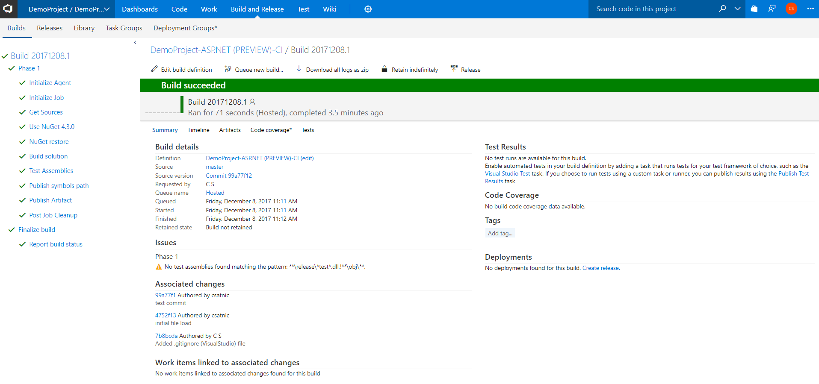
Build summary

Slide 34
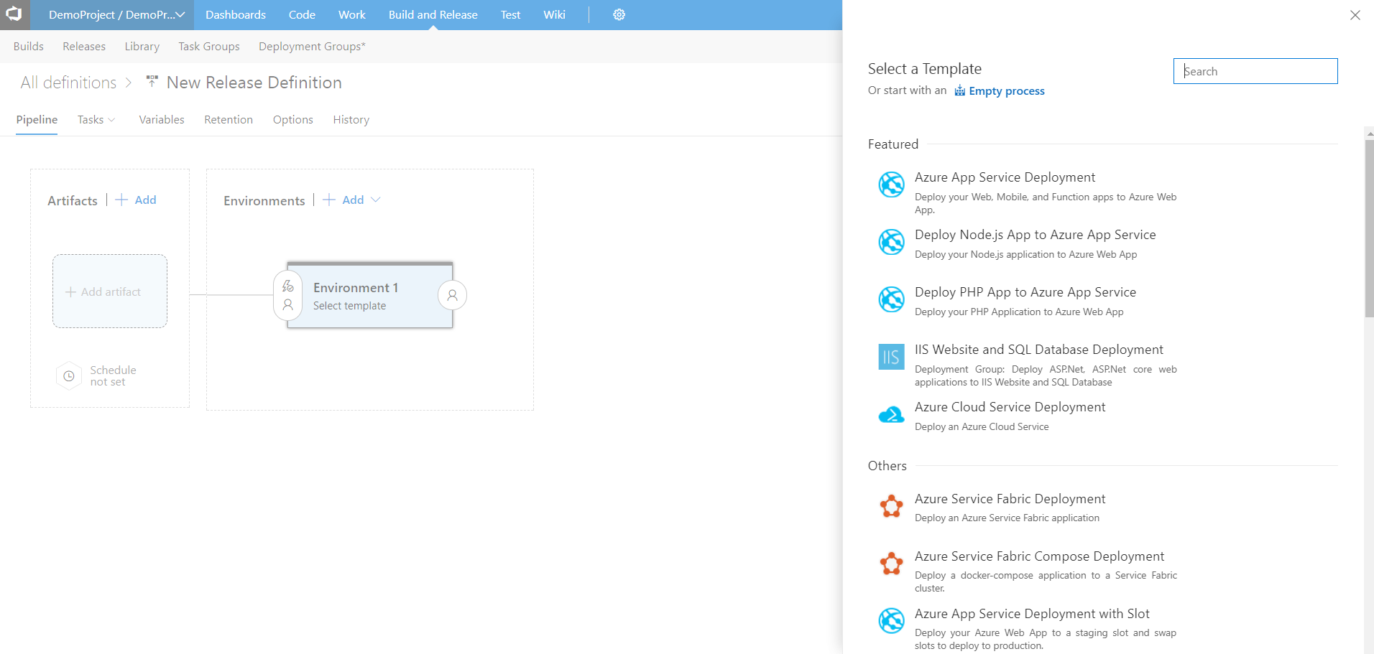
Release templates

Slide 35
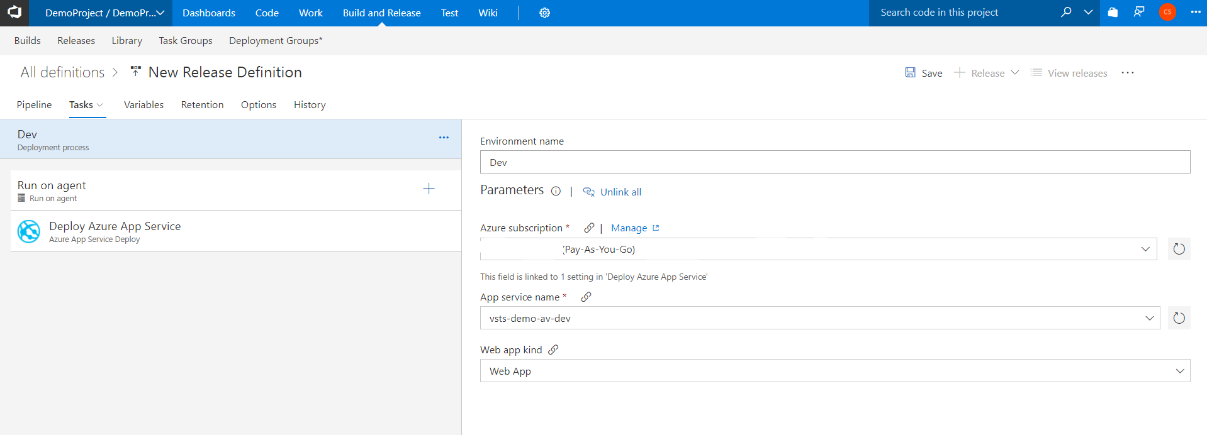
Release template options

Slide 36
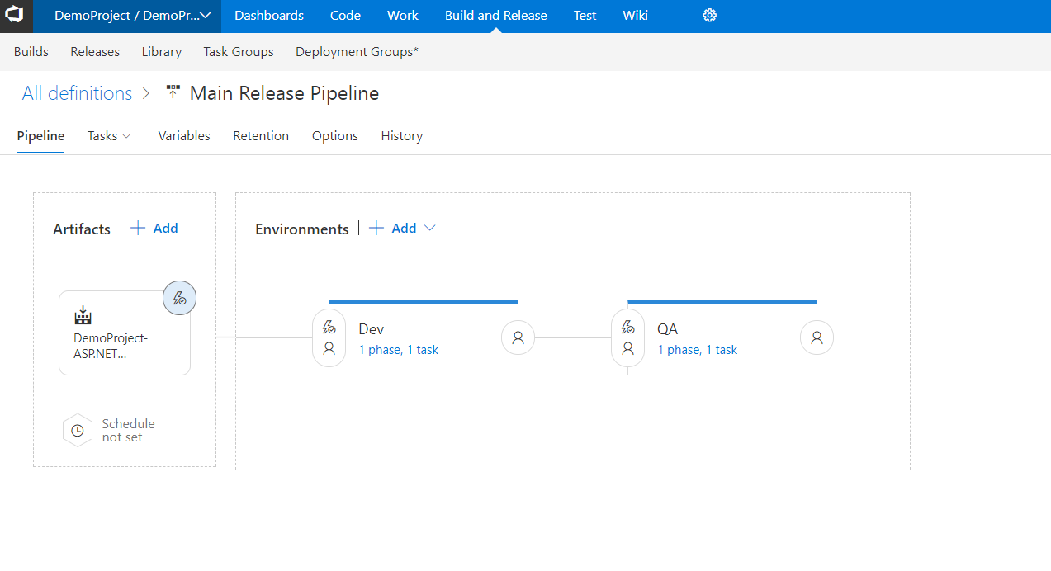
Release pipeline

Slide 37
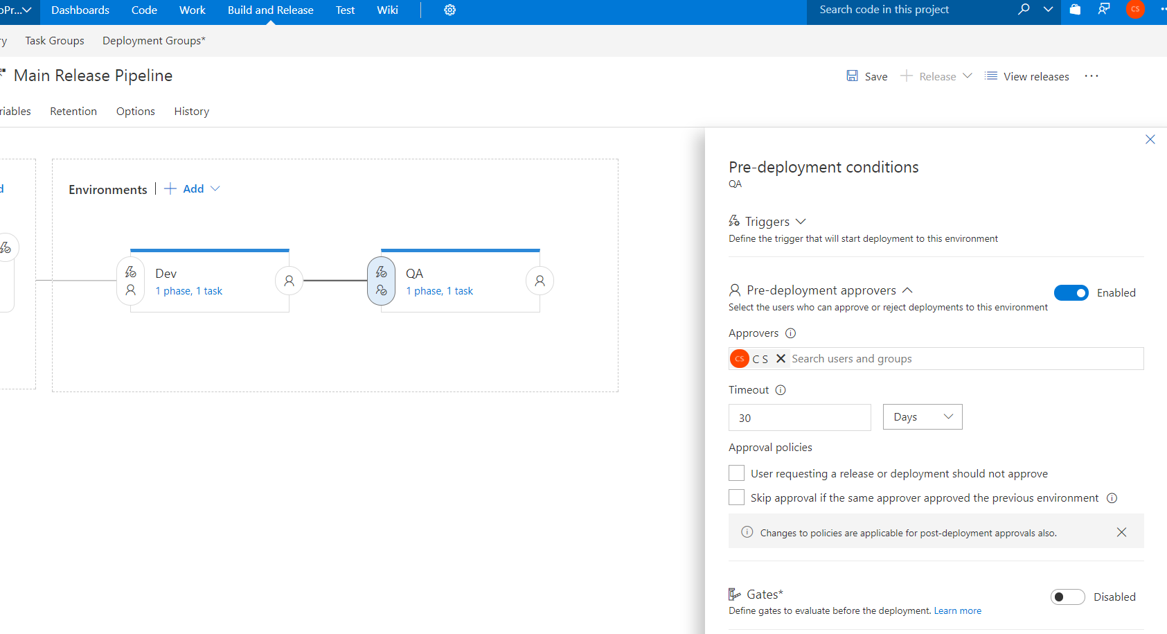
Pre-deploy conditions

Slide 38
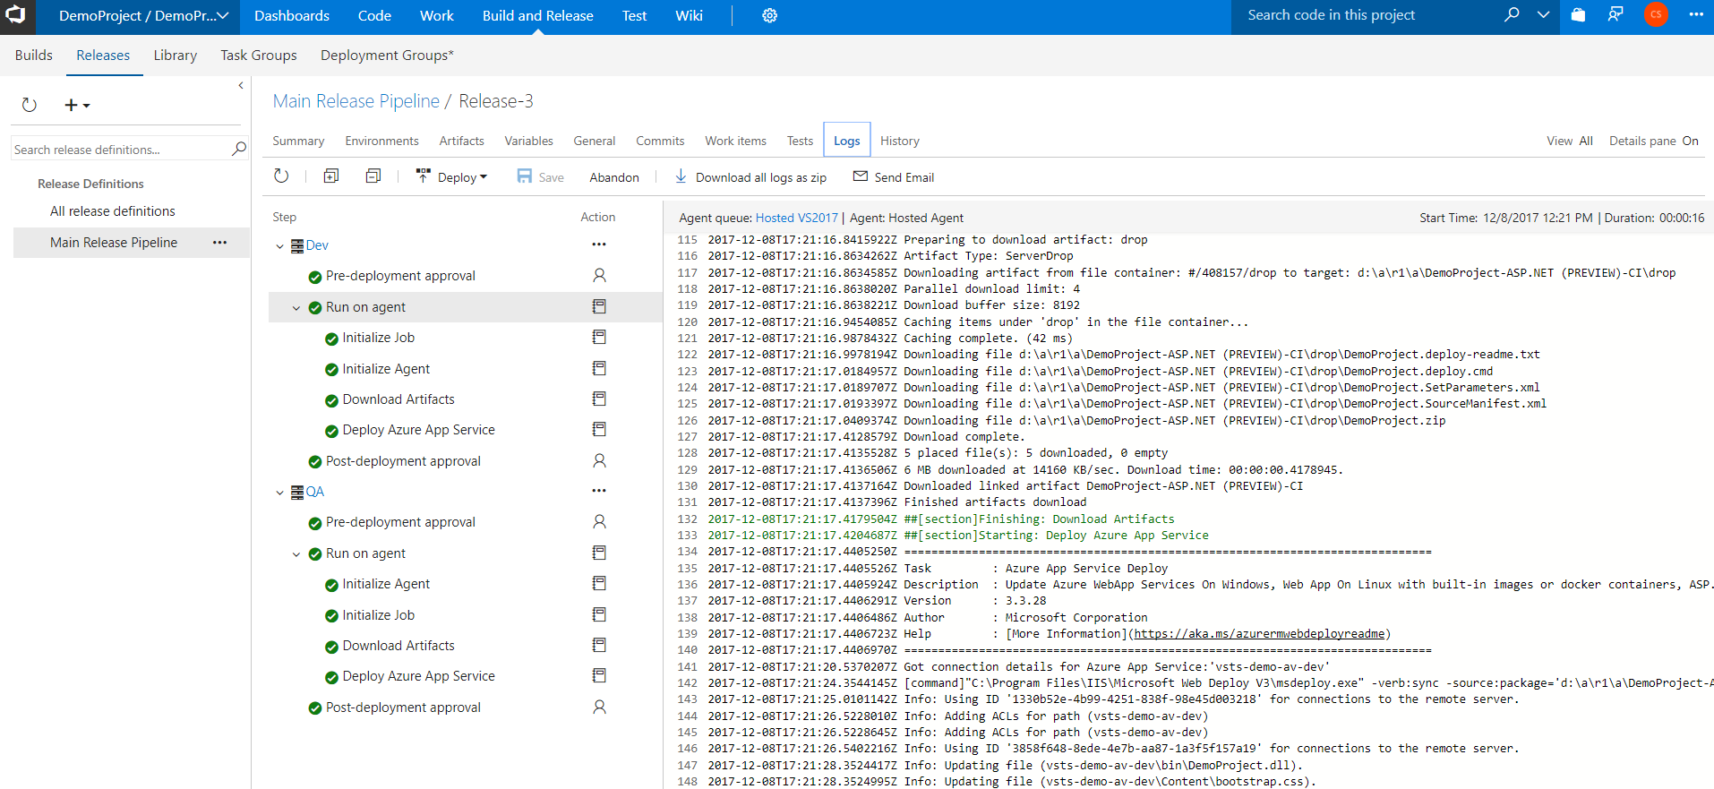
Release summary

Slide 39
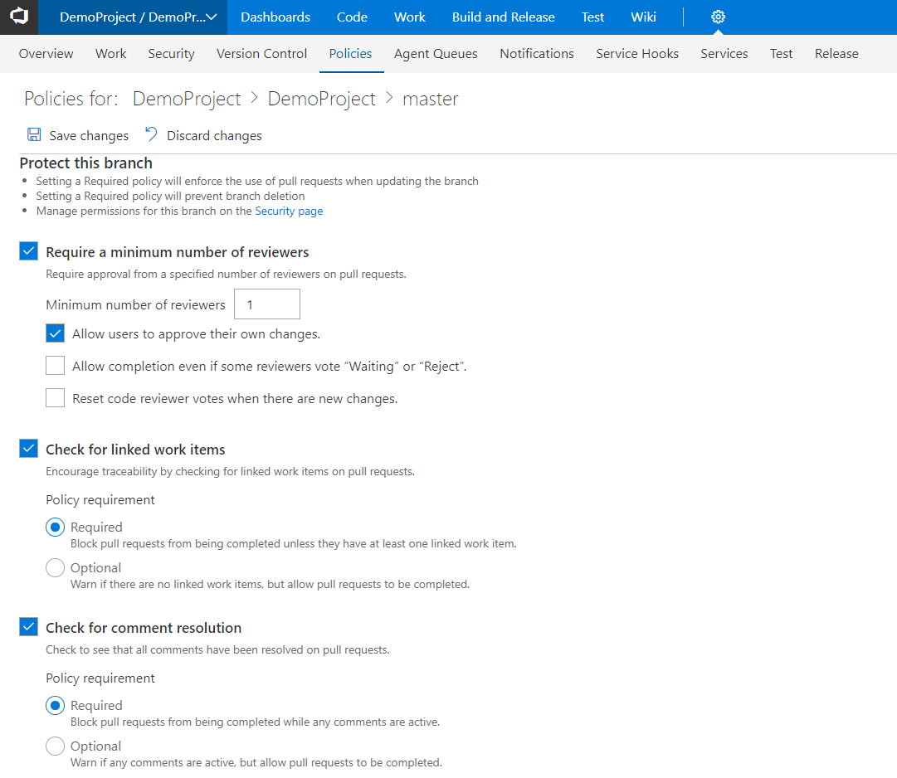
Code branch policy

Slide 40
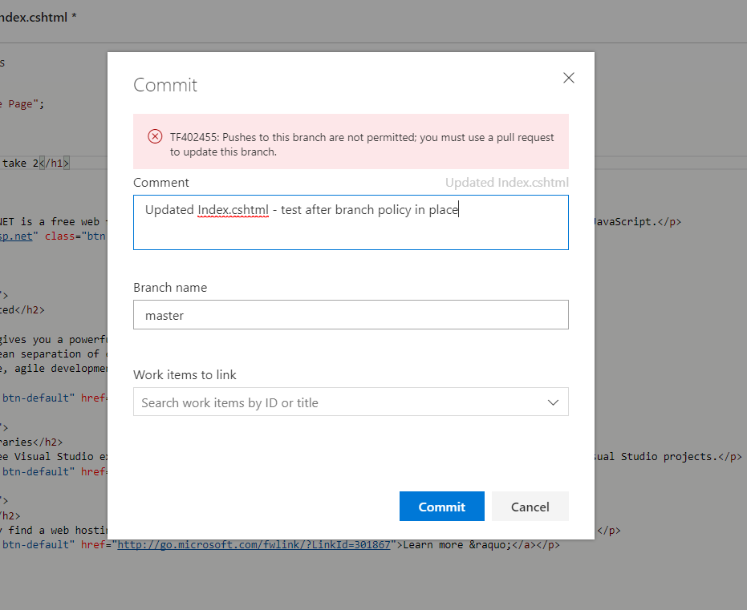
No direct commits

Slide 41
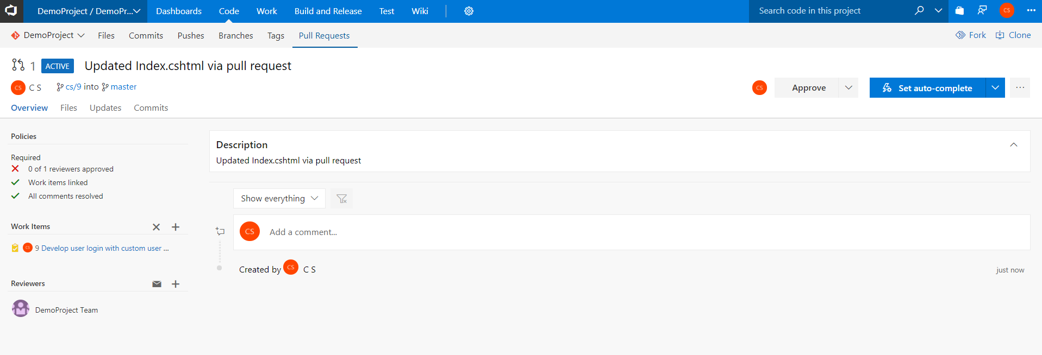
Pull request details

Slide 42
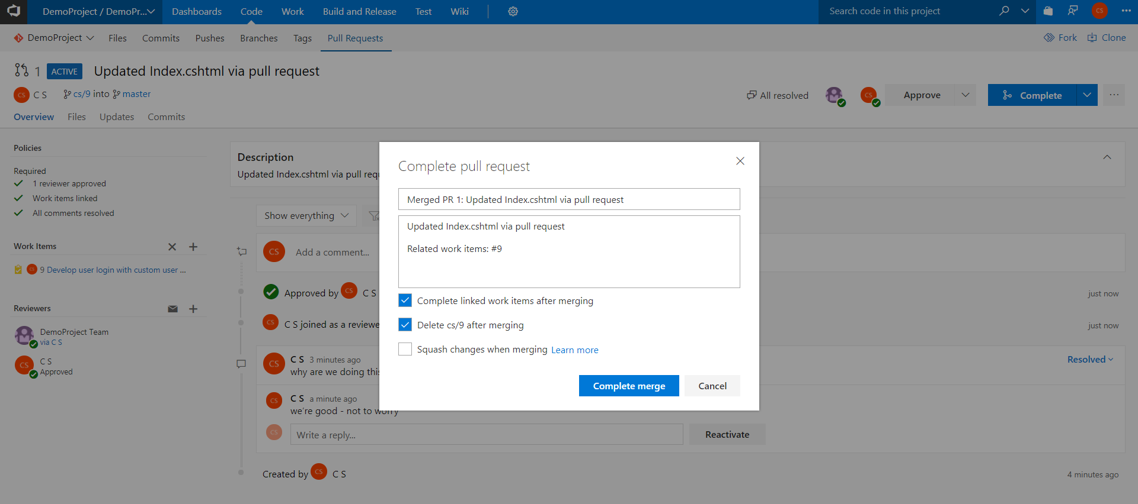
Complete pull request

Slide 43
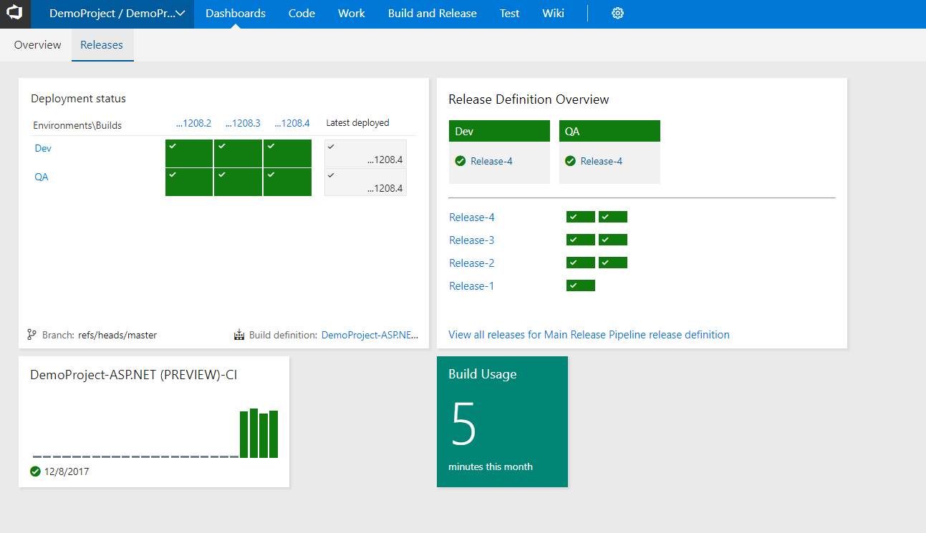
Custom dashboard

Slide 44
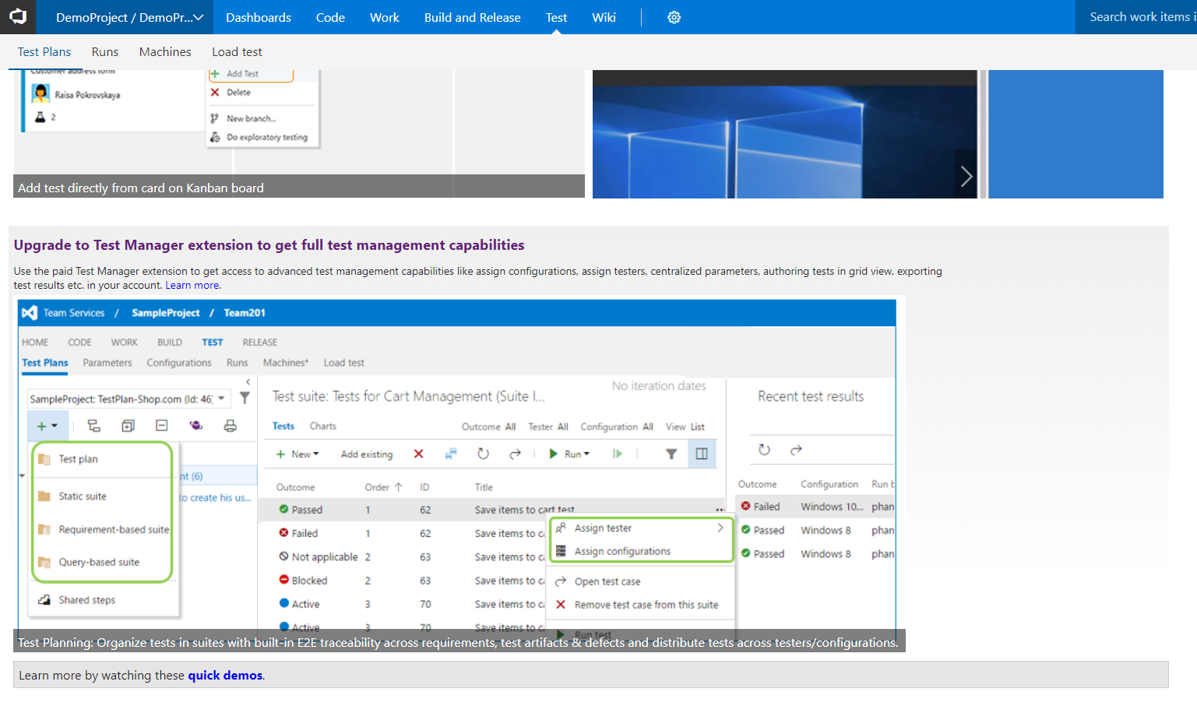
Manual test plans

Slide 45
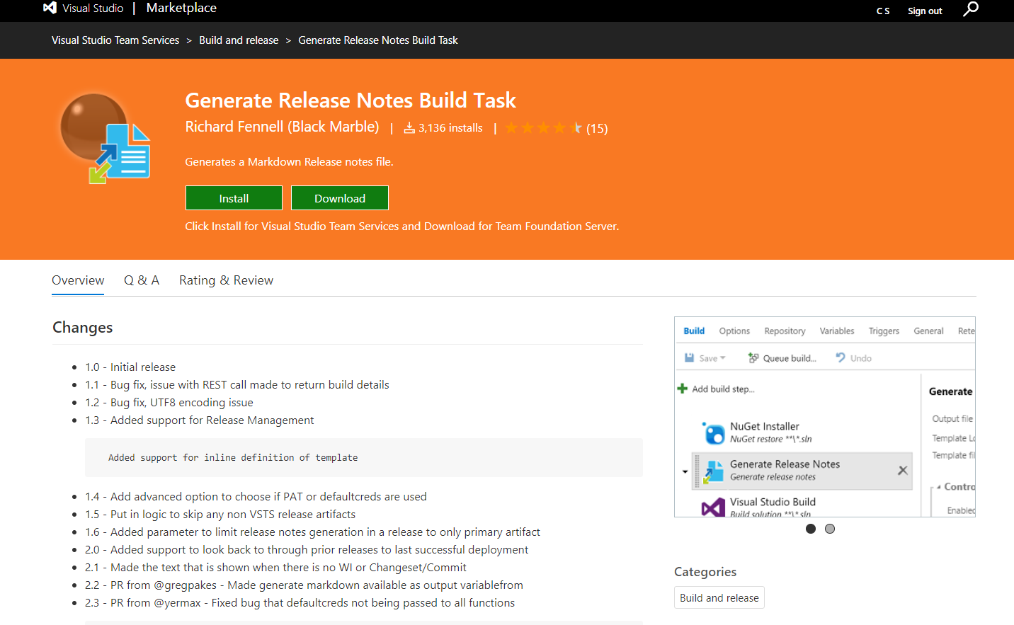
Release notes extension

Slide 46
Where to start on the DevOps journey?
Short answer: start with what hurts most
Notes:
http://donovanbrown.com/post/How-do-we-get-started-with-DevOps
where should we start? The short answer is start with what hurts most. (a typical consultant answer since each customer is probably at a different stage)
make sure team is using source control
team is firing on all cylinders as an Agile team
producing increments of shippable code, code we could deploy to an environment
work item tracking for their Epics, Features, Product Backlog Items, Bugs, tasks
visible Product Backlog and/or Kanban board
continuous integration
continuous deployment (at least to dev and then other environments)
monitoring
Just because it is not broken does not mean you cannot improve it.

Slide 47
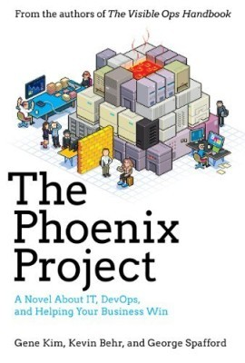
Notes:
Phoenix book - excellent novel (for everybody) about a fictional company that transforms itself using devops in order to stay relevant and competitive
People + process + products – this book offers many insights for the ‘people’ area of devops

Slide 48

Notes:
don't try to find the perfect product combination - VSTS is extensible - just start somewhere and use the components that make most sense for your scenario
remember ... VSTS is hosted and managed by Microsoft but it's for any platform and any language

